Slide 1
Special topics Session 3 Al-Zahra university Maryam zim

Slide 2
What is CSS?
Css is cascading style sheet .
Css used to style and design html page.
Remember we talk about html and css in session one as human body and CSS is similar to style.
Question: what cascading means?
It means styles apply in a priority order.
1- browser default : every browser has a default style for some tags. Example: tag <a>
2- external stylesheet : use external css file and linked it in <link> tag in <head>.
3- internal :use <style> in <head> tag.
4- inline style: use style attribute in opening tag.

Slide 3
How css add to page ?
We have 3 ways:
1- external : use external css file and linked it in <link> tag in <head>.
For example:
<link href=“style.css” rel=“stylesheet” />
2- internal :use <style> in <head> tag.
For example: <head>
<style>
<style>
</head>
3- inline style: Inline CSS is used to apply a unique style to a single HTML element.
It's defined directly within the element's opening tag using the style attribute

Slide 4
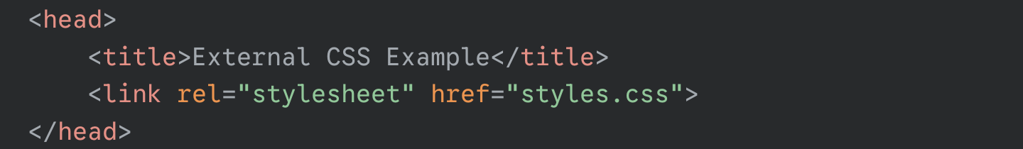
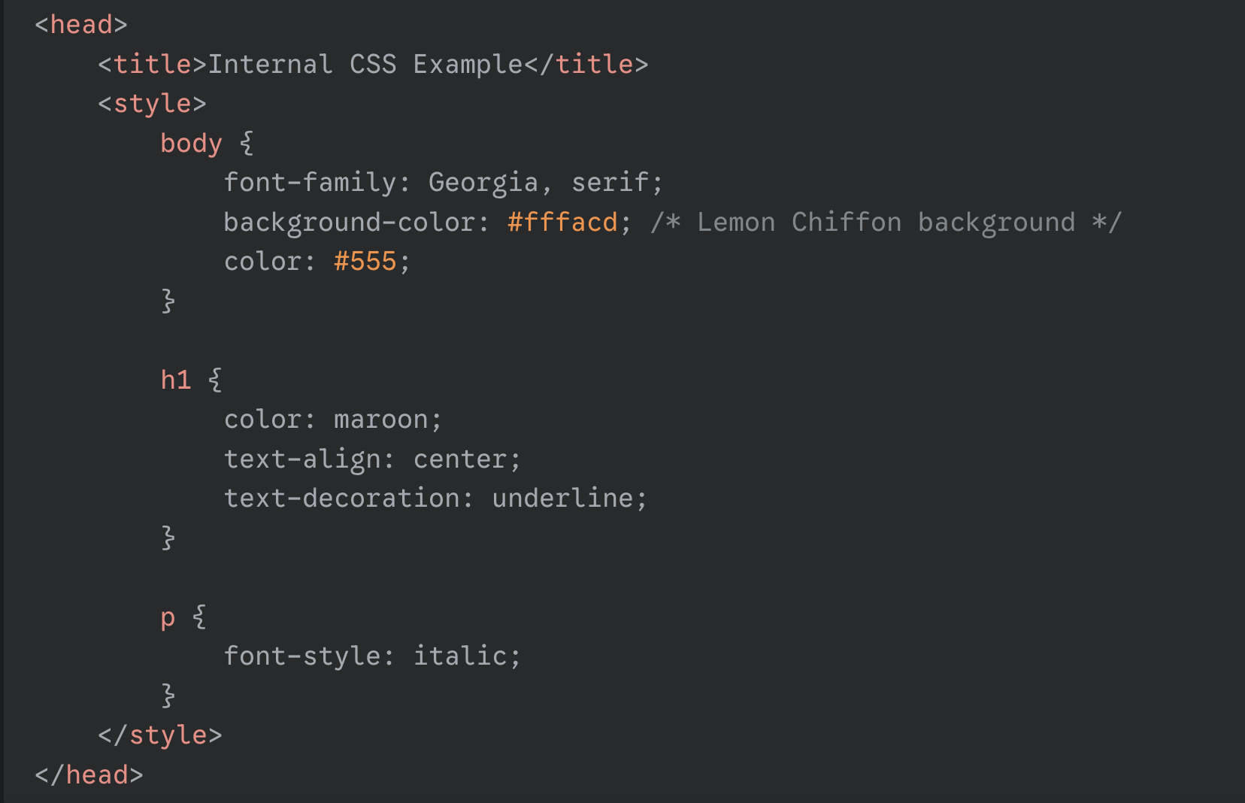
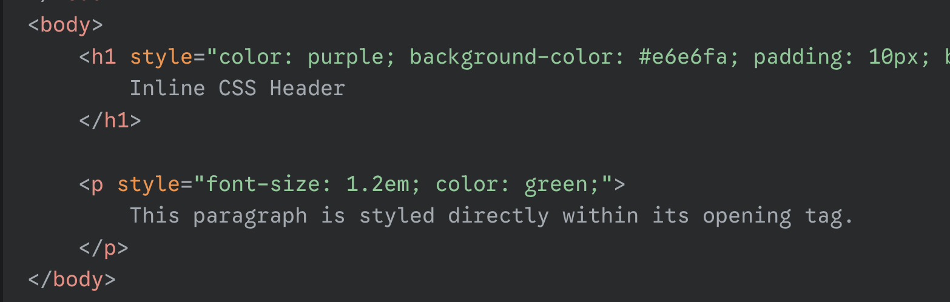
External css
Internal css
Inline css

Slide 5
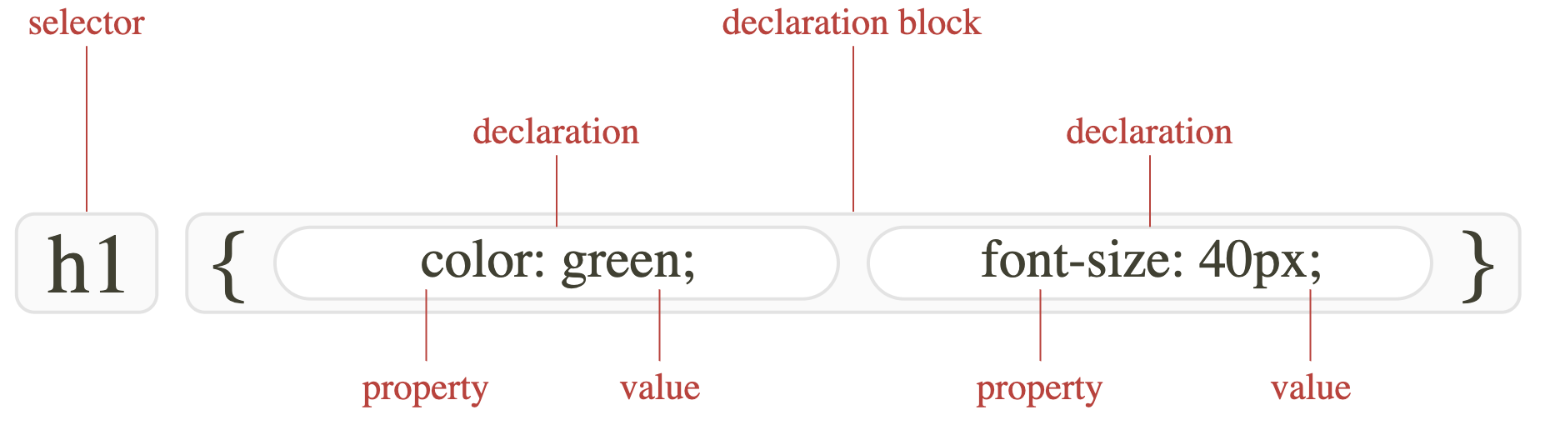
Core consept in css:
1. Selector: The Selector is the first part of the rule. It tells the browser which HTML element(s) the style should be applied to.
2. Declaration Block: The Declaration Block contains all the styles that
will be applied to the selected element. It is wrapped in curly braces ({ }).
Inside the declaration block, styles are defined as a series of Declarations, which are made up of a Property and a Value,
separated by a colon (:). Each declaration must end with a semicolon (;).
for example:

Slide 6
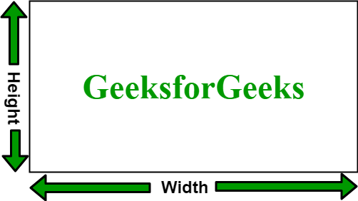
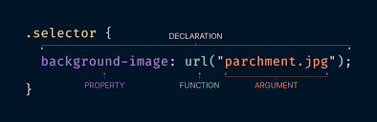
Some styles: 1- width : Sets the horizontal size of an element's content area.
2-height: Sets the vertical size of an element's content area.
3- color: The color property sets the color of an element's content.
4-background-color: The background-color property sets the solid color that fills the element's background.
Notes: for some property like color or background color we use fixed value like name of color ( For example: red, green , ..)
Or use Css function .
Question: What is Css function ?
Css function is special way of writing dynamic values.
Instead of fixed value , you use function to calculate transform or generate values.
Types of css function :
Color function
Math function
Transform and shape function
Image function

Slide 7
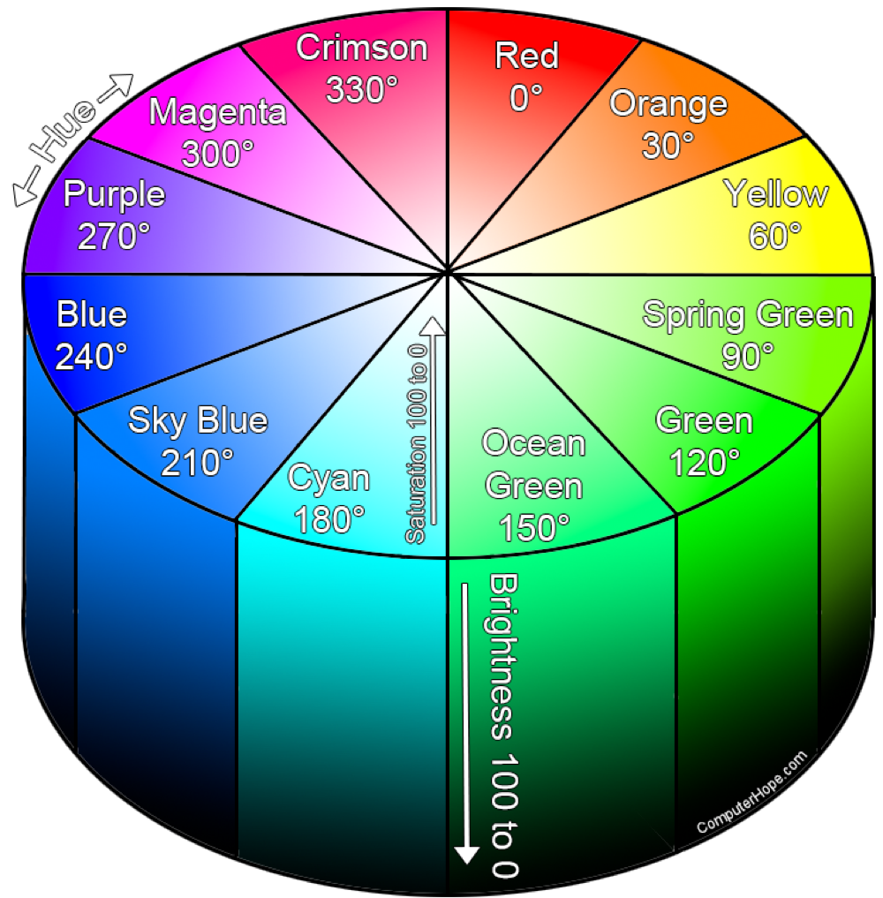
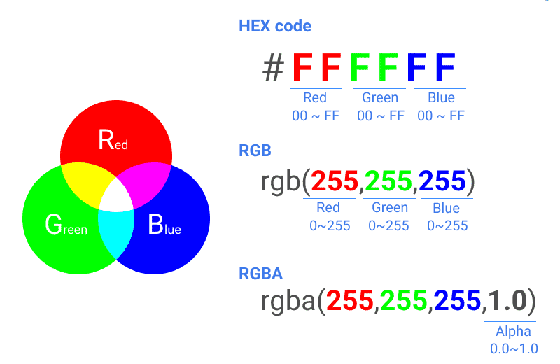
Color functions:
1. rgb(): The rgb() function takes three numerical values,
ranging from 0 (minimum intensity) to 255 (maximum intensity), corresponding to Red, Green, and Blue.
2. hsl() : The hsl() function corresponding hue, saturation and lightness takes three values.
Hue: The base color (like red, yellow, or green).
Saturation: How intense or vibrant the color is.
Lightness: How dark or bright the color is.

Slide 8
math functions:
1.calc(): The CSS calc() function performs a calculation to be used as the property value. The following operators can be used: + - * /
min(value1, value2, ...)
2. Min() & max(): The CSS min/max() function will use the smallest/largest value,
from a comma-separated list of values, as the property value. min/max(value1, value2, ...)
3. clamp() : The CSS clamp() function is used to set a value that will adjust responsively between a minimum value and
a maximum value depending on the size of the viewport.
The clamp() function has three parameters: a minimum value, a preferred value, and a maximum value.
If the preferred value is smaller than the minimum value or larger than the maximum value, the preferred value is used.
clamp(min, preferred, max)

Slide 9
units
Units in CSS like measurement units in real life.
Other hand , units tells the browser what measurement system to use value.
Types of units:
Absolute unit: not changing depending on screen size.
These units have fixed size .
for example: px , pt , cm , mm , in
2. Relative units: related to the viewport or font , etc
Font-related : em : relative to parent font-size property
rem : relative to root element font-size = <html>
Viewport related :
Vw: 1% of viewport width
Vh : 1% of viewport height
Unitless values:
some properties accept number without units like line-height , opacity , z-index

Slide 10
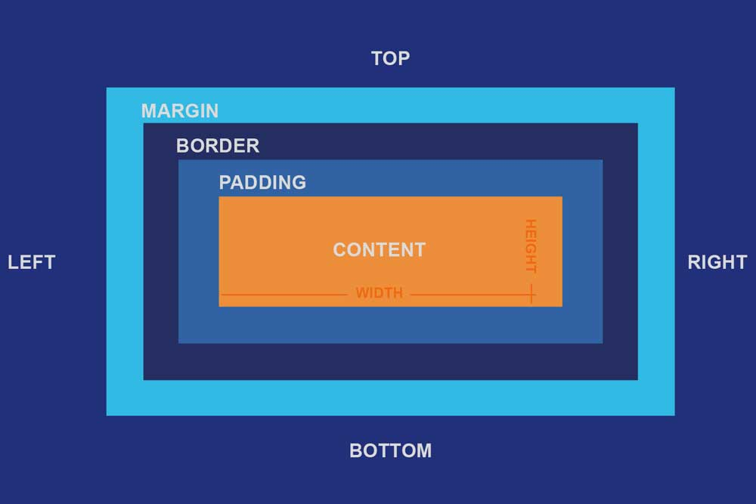
Box model
Every element has a rectangle box .
Box model explain how the browser calculate size and spacing and layout of box.
Each element has 4 layers : content : actual text , image, etc in it .
Padding : space inside box between border and content
Border: a line around padding and content
margin : space outside between element and neighbours
The amount of space an element occupies : content + padding + border + margin

Slide 11
Padding / margin value :
When you want to define margin or padding in first you can use individual sides : for example:
Padding-wight or margin right .
Finally : padding-${top , right , bottom , left}
Same for Margin.
Or you can use single , two , three, four values.
single value : applies all 4 sides.
Two values : 2px 3px => first value: top/bottom and second value : right/left
Three values: 2px 5px 10px => first value : top , second value: right/left , third value : bottom
Four value : 2px 3px 10px 5px => top right bottom left
You can these units : % , px , pt , rem , em , etc .

Slide 12
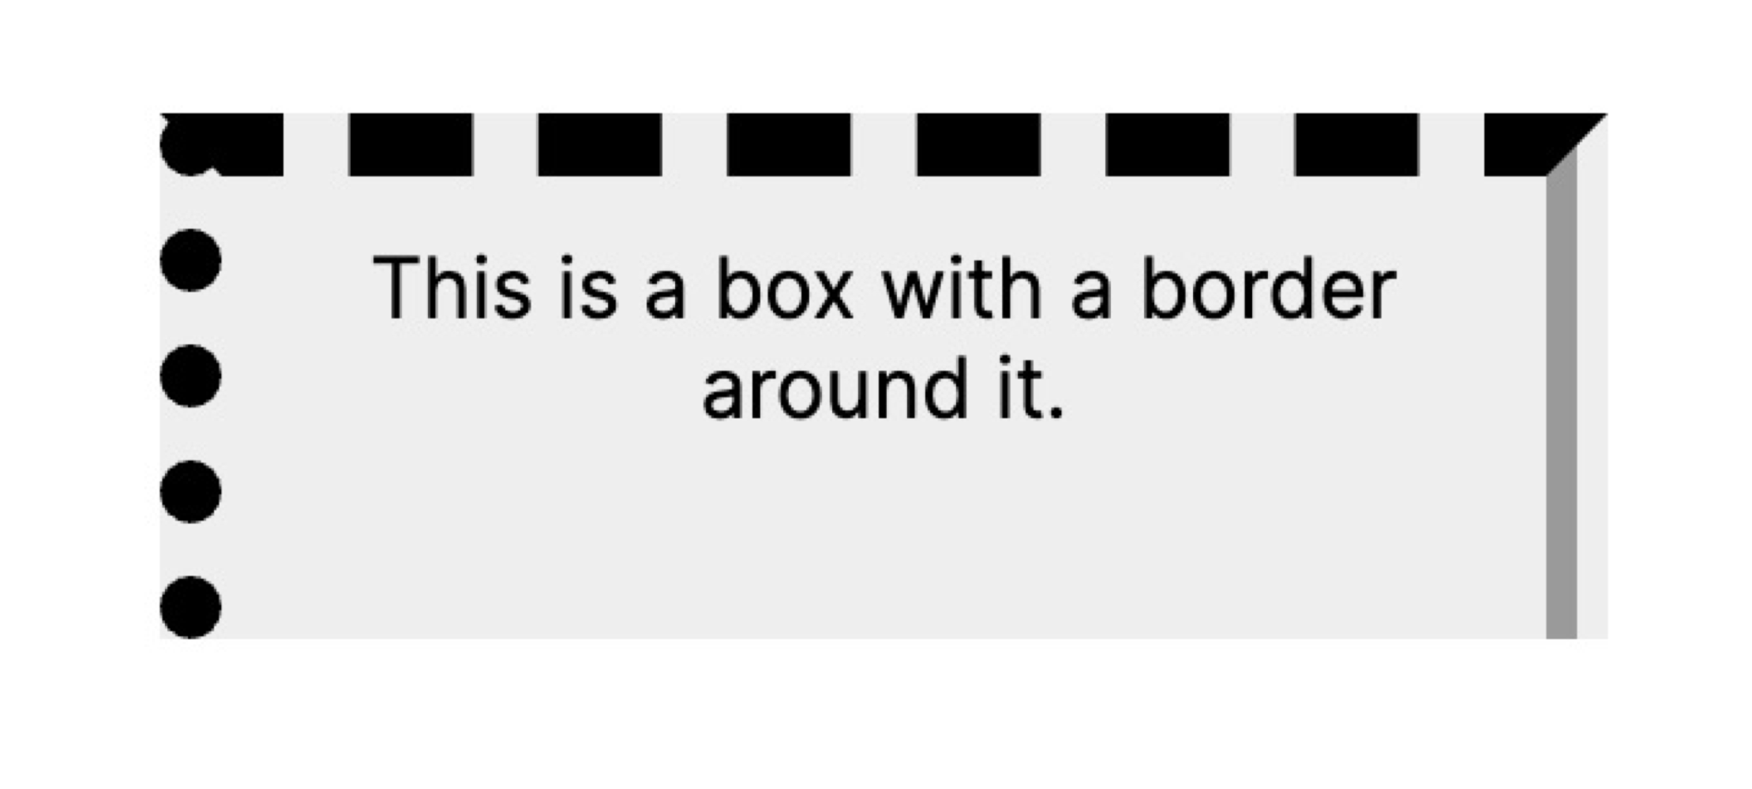
Border:
The line around padding and content is border.
Border properties :
1-border-width: controls the thickness of the border.
2. Border-style : show style of border => values: none - dashed - dotted- solid
3. Border-color : color of border
Shorthand border:
Border : width style color :
Border 3px solid red;

Slide 13
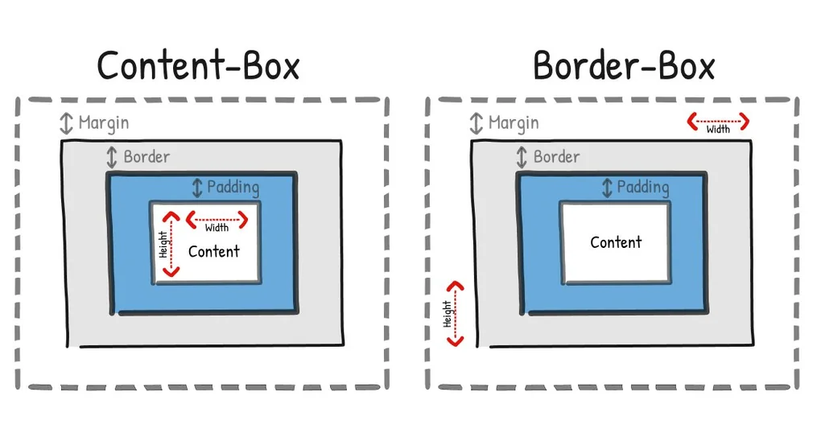
Box sizing:
It’s a CSS property that tells the browser how to calculate the total width/height.
Box-sizing values:
content-box : only content area => padding + width/height + border-width
Border-box: we declare width and height and everything such as (content , padding , border-width) is included the box.

